Slide 1
Lecture 1- Introduction to Object-Oriented Programming
Outline
1.1 Machine Languages, Assembly Languages and High-Level Languages
1.2 History of C++
1.3 History of Java
1.4 Java Class Libraries
1.5 Other High-Level Languages
1.6 Structured Programming
1.7 The Internet and the World Wide Web
1.8 Basics of a Typical Java Environment

Slide 2
Course Outline
Course Title | Object Oriented Concepts and Programming
Course Code | CSC241
Credit Hours | 4(3,1)
Semester | Fall 2015
Resource Person | Dr. Qurratulain Malik
Contact Hours (Theory) | 3 hours per week
Contact Hours (Lab) | 3 hours per week
Office Hours
Email | Qurratulainmalik@ciitlahore.edu.pk

Slide 3
Course Outline
GENERAL OVERVIEW
This course provides an introduction to the concepts and methodology of Object-Oriented Programming with Java as an illustration language.
Course also help students to implement object-oriented concepts keeping in mind the real-world problems.
COURSE OBJECTIVES
Understand major concepts of object-oriented programming
Knowledge and skills in OO design and program development
Experience in Java programming and program development within an integrated development environment
Certain skills in using graphical user interface
Topics covered in this course provide a foundation for more advanced courses in Computer Science

Slide 4
Course Outline
TEXT BOOK
“Java How to Program”, by Deitel & Deitel, 8th Edition
RECOMMENDED BOOKS
“Java 2: The Complete Reference”, by Patrick Naughton and Herbert Schildt
“Thinking in Java” by Bruce Eckel, Prentice Hall, 4th Edition, 2006
“Beginning Java 2” by Ivor Horton

Slide 5
Course Assessment
Theory Part
Sessional-I Exam 10%
Sessional-II Exam 15%
Final Exam 50%
Quiz (4-6 per semester) 15%
Assignments (4-6 per semester) 10%
Quizzes may be unannounced. There is no make-up for missed quiz.
Practical / Lab Part
Performance or experiments 25%
Sessional-I Exam 10%
Sessional-II Exam 15%
Final Exam 50%
The minimum pass marks for each course shall be 50%. Students obtaining less than 50% marks in any course shall be deemed to have failed in that course.

Slide 6
Course Assessment
Grades | Letter Grade | Credit Points | Percentage Marks
A | ( Excellent) | 4.0 | 90 and above
A- |  | 3.7 | 85-89
B+ |  | 3.3 | 80-84
B | (Good) | 3.0 | 75-79
B- |  | 2.7 | 70-74
C+ |  | 2.3 | 65-69
C | (Average) | 2.0 | 60-64
C- |  | 1.7 | 55-59
D | (Minimum passing) | 1.3 | 50-54
F | (Failing) | 0.0 | Less than 50

Slide 7
Course Outline
Weeks | Topic of Lecture | Reading Assignment
Week 1 | Course Overview Introduction to Java, History The Java Development Environment | Chapter 1& 2
Week 2 & 3 | Object Oriented Concepts in Java, Classes, Objects, Methods Constructors Difference between OOP and procedural languages | Chapter 3
Week 4 | Control Statements if, if-else, while, do-while, switch | Chapter 4 & 5
Week 5 | Methods Unified Modeling Language State Diagram Use Case Diagram Class Diagram Activity Diagram | Chapter 6 + Handouts
Week 6 | Arrays | Chapter 7
Week 7 & 8 | A deeper look into Java Classes and Objects, Encapsulation and data hiding Data abstraction | Chapter 8 + Handouts

Slide 8
Course Outline (Contd)
Week 9 & 10 | Object Oriented Programming: Inheritance | Chapter 9 + Handouts
Week 11 | Object Oriented Programming: Polymorphism | Chapter 10
Week 12 & 13 | GUI components and Graphics | Chapter 11 & 12
Week 14 | Exception Handling | Chapter 13
Week 15 & 16 | Accessing Database with JDBC | Chapter 25 & Handouts

Slide 9
Attendance Policy
A Minimum of 80% of attendance is required for sitting in the Final/Terminal examination.
Any student having less than 80% attendance will receive “F” Grade regardless of his/her performance in previous exams, quizzes and assignments etc.

Slide 10
Lecture 1
Introduction

Slide 11
1.1 Machine Languages, Assembly Languages and High-Level Languages
Machine language
  “Natural language” of computer component
  Machine dependent
Assembly language
  English-like abbreviations represent computer operations
  Translator programs convert to machine language
High-level language
  Allows for writing more “English-like” instructions
    Contains commonly used mathematical operations
  Compiler convert to machine language
Interpreter
  Execute high-level language programs without compilation

Slide 12
1.2 History of C++
C++
  Evolved from C
    Evolved from BCPL and B
  Provides object-oriented programming capabilities
Objects
  Reusable software components that model real-world items

Slide 13
1.3 History of Java
Java
  Originally for intelligent consumer-electronic devices
  Then used for creating Web pages with dynamic content
  Now also used for:
    Develop large-scale enterprise applications
    Enhance WWW server functionality
    Provide applications for consumer devices (cell phones, etc.)

Slide 14
C, C++ and Java History
C → C++ → Java
1972 | Early 1980s | 1995
Dennis Ritchie (Bell Laboratories) | Bjarne Stroustrup(Bell Laboratories) | James Gosling (Sun Microsystems)
UNIX OS development language | Capabilities of Object Oriented Programming Hybrid Language (C/Object Oriented Style) | General purpose Class based Object Oriented Write once, run anywhere

Slide 15
1.4 Java Class Libraries
Classes
  Contain methods that perform tasks
    Return information after task completion
  Used to build Java programs
Java contains class libraries
  Known as Java APIs (Application Programming Interfaces)

Slide 16
1.5 Other High-Level Languages
Fortran
  FORmula TRANslator
COBOL
  COmmon Business Oriented Language
Pascal
Basic

Slide 17
1.6 Structured Programming
Structured Programming
  Structured programs
    Clearer than unstructured programs
    Easier to test, debug and modify
  Pascal designed for teaching structured programming
  ADA
    Multitasking
  C
  Assignment 1: Differentiate between Procedural, Structural & Object Oriented Programming.

Slide 18
1.7 The Internet and the World Wide Web
Internet
  Developed over three decades ago with DOD funding
  Originally for connecting few main computer systems
  Now accessible by hundreds of millions of computers
World Wide Web (WWW)
  Allows for locating/viewing multimedia-based documents

Slide 19
1.8 Basics of a Typical Java Environment
Java systems contain
  Environment
  Language
  APIs
  Class libraries

Slide 20
1.8 Basics of a Typical Java Environment (cont.)
Java programs normally undergo five phases
  Edit
    Programmer writes program (and stores program on disk)
  Compile
    Compiler creates bytecodes from program
  Load
    Class loader stores bytecodes in memory
  Verify
    Verifier ensures bytecodes do not violate security requirements
  Execute
    Interpreter translates bytecodes into machine language

Slide 21
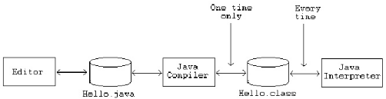
Phases of Java Program
The following figure describes the process of compiling and executing a java program.

Slide 22
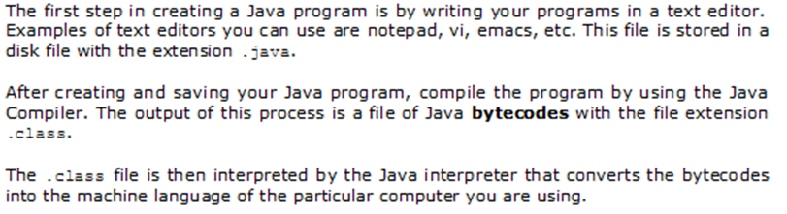
Phases of Java Program (Contd)
Task | Tool to Use | Output
Write the program | Any text Editor | File with .java extension
Compile the program | Java Compiler javac Myprogram.java | File with .class extension (Java bytecodes)
Run the program | Java Interpretor java MyProgram | Program output

Slide 23
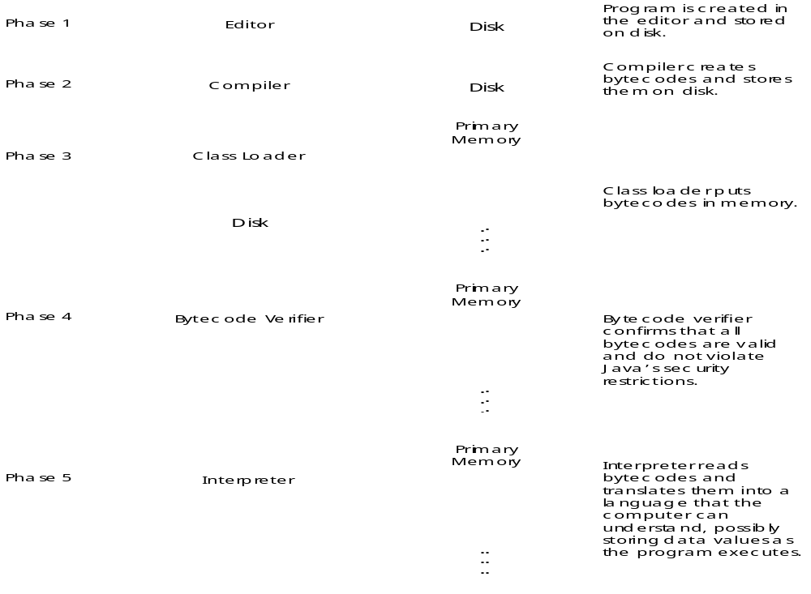
Fig. 1.1 A typical Java environment.

Slide 24
Goals: Java Language
Versions
It should be "simple, object-oriented and familiar".
It should be "robust and secure".
It should be "architecture-neutral and portable".
It should execute with "high performance".
It should be "interpreted, threaded, and dynamic".
Major release versions of Java, along with their release dates:
JDK 1.0 (January 23, 1996)
JDK 1.1 (February 19, 1997)
J2SE 1.2 (December 8, 1998)
J2SE 1.3 (May 8, 2000)
J2SE 1.4 (February 6, 2002)
J2SE 5.0 (September 30, 2004)
Java SE 6 (December 11, 2006)
Java SE 7 (July 28, 2011)

Slide 25
Benefits of Java to Programming Community
Support GUIs and multimedia capabilities such as graphics, images, animation, audio and video.
Run on internet and communicate with other applications
Applications can take advantage of the flexibility and performance improvements of multithreading
Applications with richer file processing than is provided by C or C++.

Slide 26
Benefits of Java to Programming Community
Not limited to the desktop or even to some local computer network, but can integrate Internet components and remote databases as well.
Applications that can be written quickly and correctly in a manner that takes advantage of prebuilt software components.
Easy access to a growing universe of reusable software components.
Programmers want all these benefits in a truly portable manner, so that applications will run without modification on a variety of platforms

Slide 27
Motivation
The original motivation for java
The need for platform independent language that could be embedded with various consumer electronic products like toasters and refrigerators
One of the first project developed using java
  A personal handheld remote control names start 7.
At the same time world wide web and internet was gaining popularity. Gosling et. Al. realized that Java could be used for Internet programming.

Slide 28
Integrated Development Environments
Note that taste in IDEs is a highly personal matter, but Eclipse, JBuilder, and Sun Java Studio (in that order) appear to be the most popular choices.
Eclipse
The Eclipse IDE for Java Developers contains what you need to build Java applications. The Eclipse IDE for Java Developers provides superior Java editing with validation, incremental compilation and much more.
For downloading Eclipse, please visit http://www.eclipse.org/downloads/ and download Eclipse IDE for Java Developers
JCreator
JCreator is a powerful IDE for Java. JCreator is the development tool for every programmer that likes to do what he does best: programming. It is faster, more efficient and more reliable than other Java IDE’s. Therefore it is the perfect tool for programmers of every level, from learning programmer to Java-specialist.

Slide 29

Introduction to Object Oriented Programming
Java: Today’s most popular software development language
Developed by Sun Microsystems
Implementation at java.sun.com/j2se
Object Oriented Programming
Portable (computer programs written in the Java language must run similarly on any hardware/operating-system platform).

Slide 30
JAVA
James Gosling, Mike Sheridan, and Patrick Naughton initiated the Java language project in June 1991.
Java was originally designed for interactive television, but it was too advanced for the digital cable television industry at the time.
The language was initially called Oak after an oak tree that stood outside Gosling's office; it went by the name Green later, and was later renamed Java, from Java coffee, said to be consumed in large quantities by the language's creators.
Sun Microsystems released the first public implementation as Java 1.0 in 1995. It promised "Write Once, Run Anywhere" (WORA), providing no-cost run-times on popular platforms.
With the advent of Java 2 , new versions had multiple configurations built for different types of platforms. For example, J2EE targeted enterprise applications and the greatly stripped-down version J2ME for mobile applications (Mobile Java). J2SE designated the Standard Edition.
In 2006, for marketing purposes, Sun renamed new J2 versions as Java EE, Java ME, and Java SE, respectively.
In 2007, Sun made the Java's core code available under free software/open-source distribution terms.

